Slide 1

The 1730s
The World of Jonathan Edwards

Slide 2
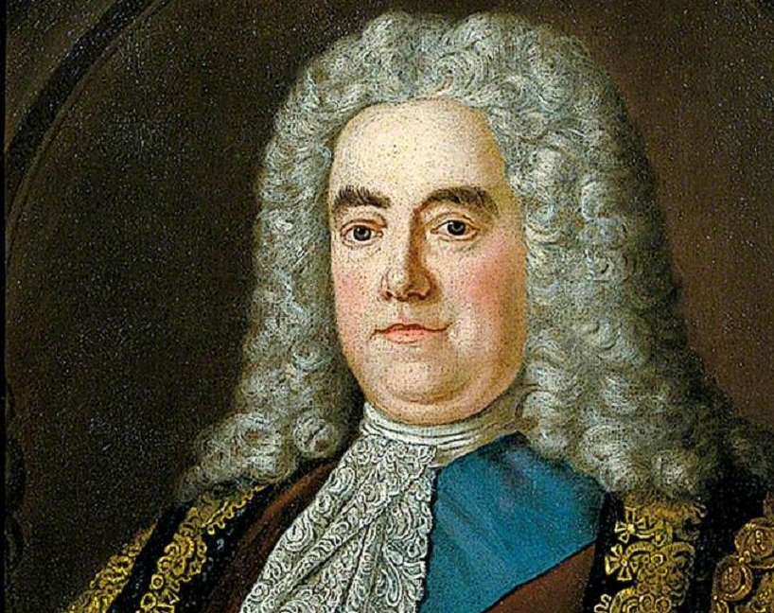
England, 1730s
Stability
Money
“Prime Minister”

Slide 3

Declension?

Slide 4
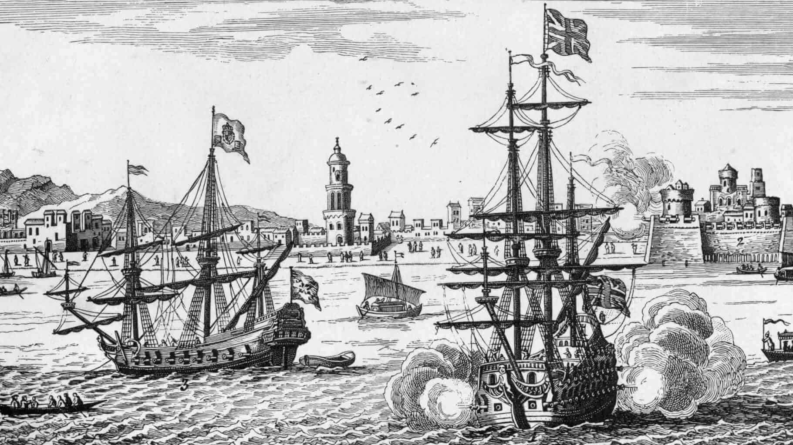
War of Jenkin’s Ear

Slide 5
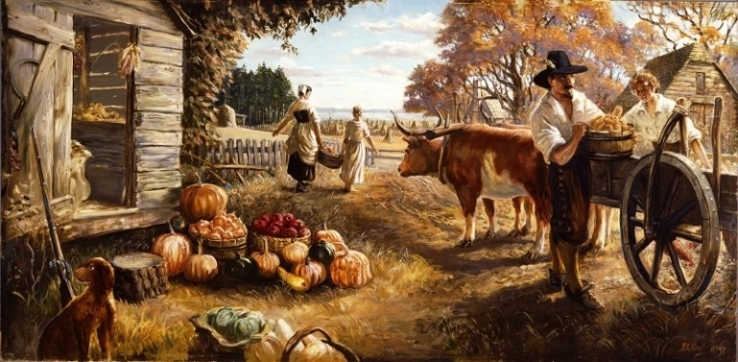
Colonial America
New England legal codes
Government and legislature
Social hierarchy and structure

Slide 6
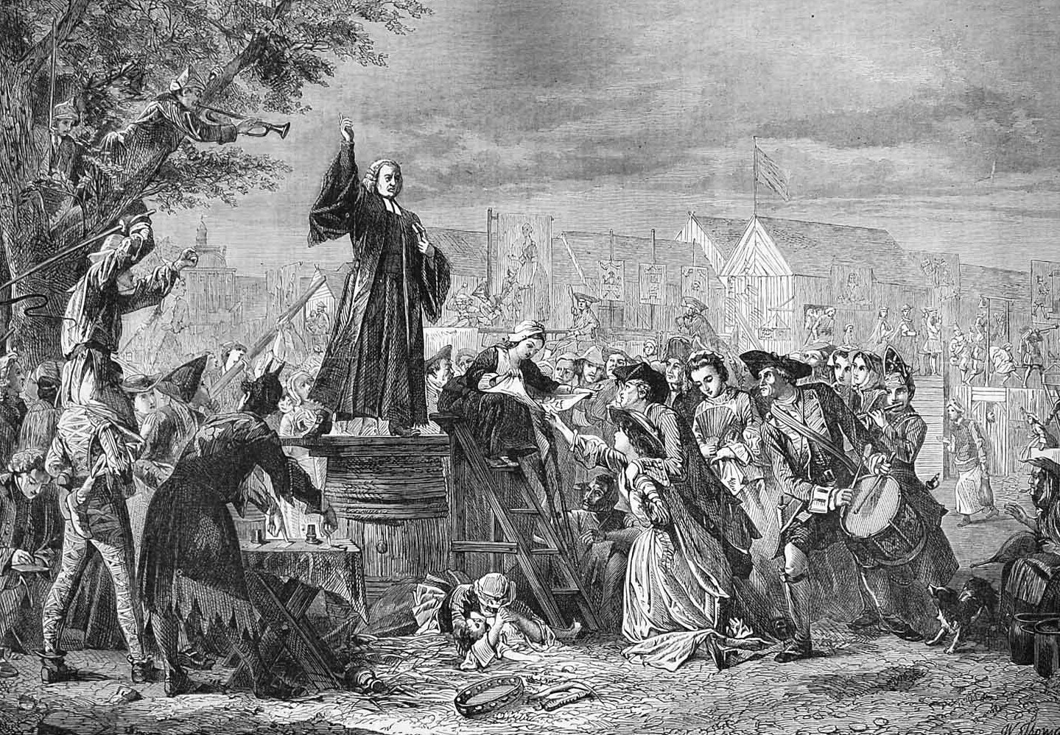
Great Awakening
The 1730s saw the beginning of the Great Awakening in Northampton

Slide 7

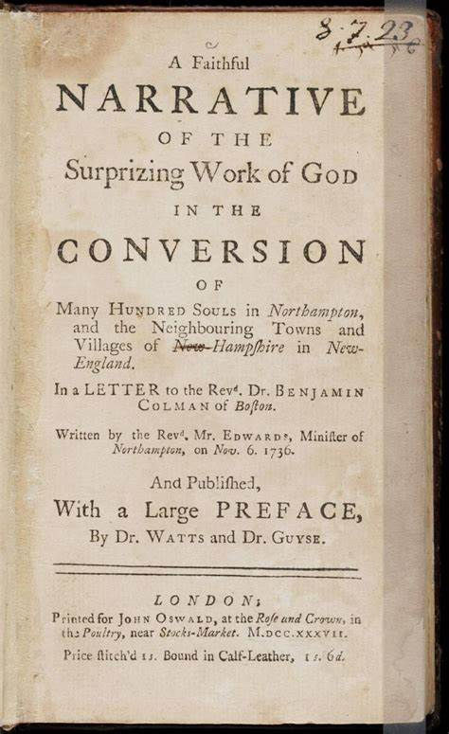
Sinners in the Hands of an Angry God
Religious Affections
The Excellency of Christ
Justification by Faith Alone
Mention of Communion as a Converting Ordinance

Slide 8
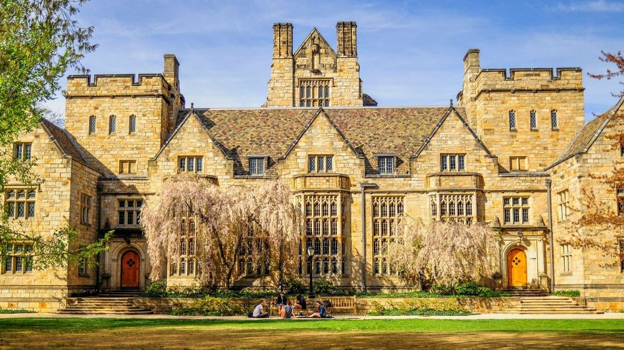
John Cleaveland
From Massachusetts farm boy
to Connecticut rebel

