Slide 1
The 1740s:
The Great Awakening
Presentation by Clay Ward and Ethan Richards

Slide 2


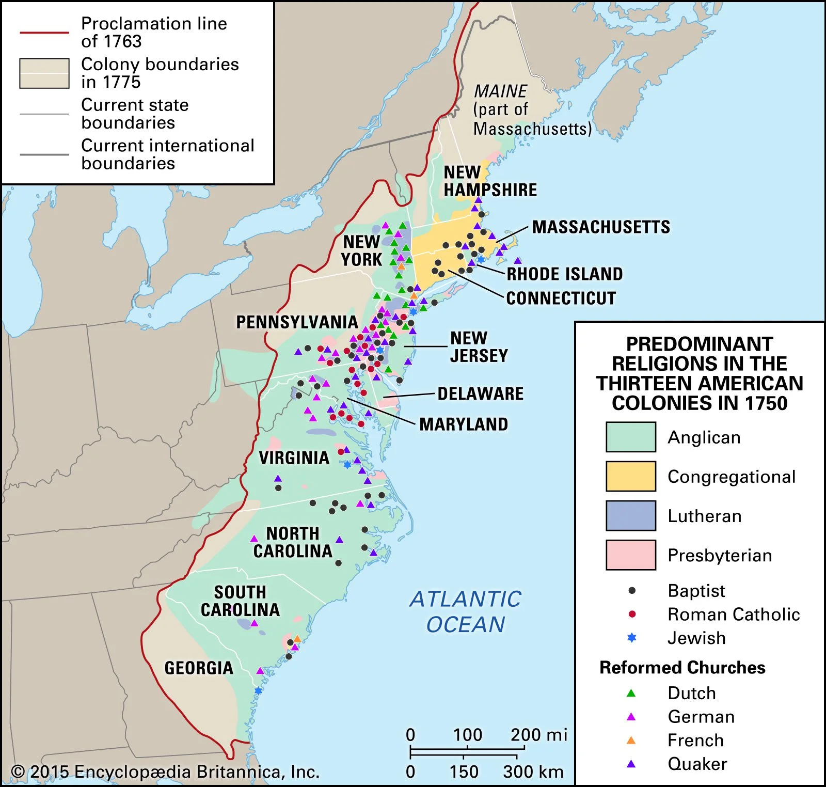



Church Background
Ecclesiastical Landscape
  Formal worship
  Church government
Theological Landscape
  Key, Pre-Awakening theologians: Stoddard, Edwards, Tennent, Chauncy
  Issues of the day
    True church membership
    The Half-way Covenant
    Trans-Atlantic synods

Slide 3
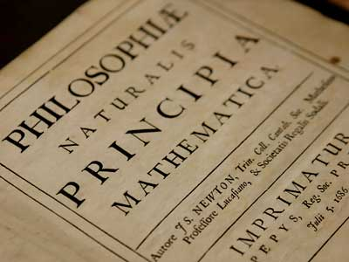
The "Enlightenment"
Relationships
  Faith and Reason
  Church and State
  Individual and Community
Key figures
  Isaac Newton
  Benjamin Franklin
  Jonathan Edwards

Slide 4
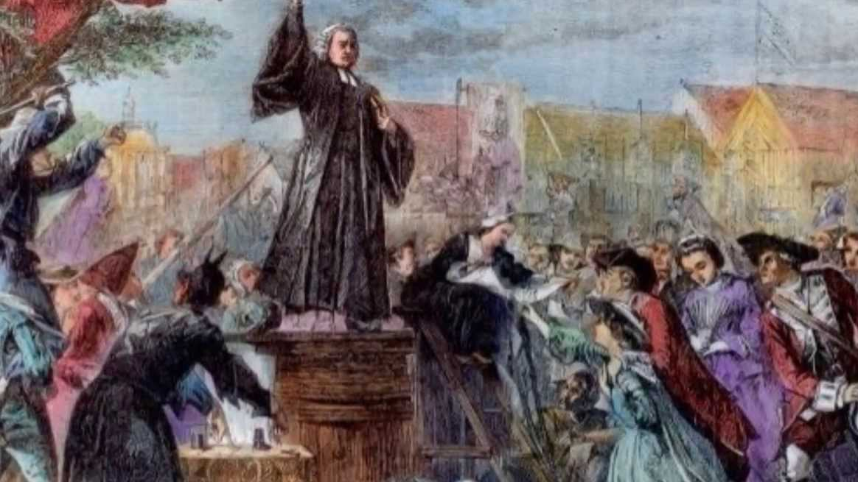
The Great Awakening

Slide 5
The Message: New Birth
Salvation as an experience > as an intellectual acknowledgement
The inadequacy of only formal religion
Question:
  Is this message Puritanism returned, or an innovation?
Notable Works of the Time
The Danger of an Unconverted Ministry (1740)
The Distinguishing Marks of the Works of the Spirit of God (1741)
Some Thoughts Concerning the Present Revival of Religion (1742)
Enthusiasm, Described and Caution'd Against (1742)
Sinners in the Hands of an Angry God (1741)
The Religious Affections (1746)

Slide 6
Features of the Great Awakening
The Men
The Methods
The Motives
Notable Proponents
  John Wesley (England)
  George Whitefield
  Jonathan Edwards
  Gilbert Tennent
Other Voices
  Benjamin Franklin
  Charles Chauncy
Informal/Itinerant Preaching
Sentimental appeal (Ruth's Resolutions)
Explicit appeals to the will
Response to Formalism and Enlightenment
The need for Experience
Bringing the Gospel to the people

Slide 7
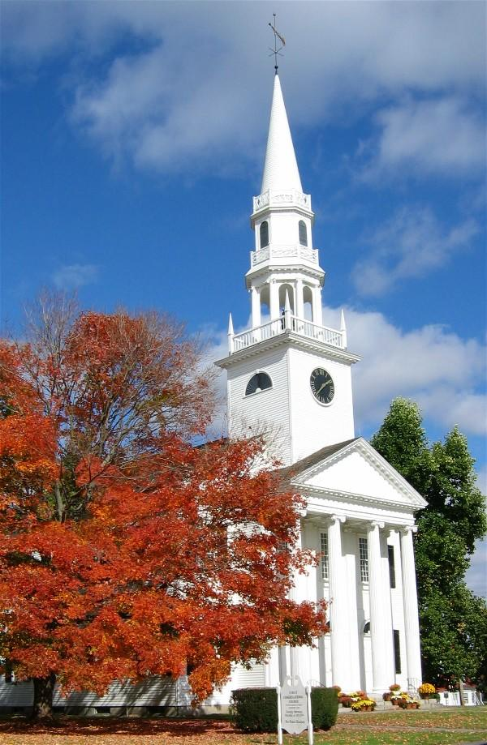
Consequences of the Awakening

Slide 8
Church and Culture
Ecclesiastical Disruption
Cultural Unification
Old Lights vs. New Lights
Denominational division—or purification?
Arminian accusations
Modern evangelicalism
Increased religious affiliation
An American identity
Heightened Individualism
A generation away from revolution

Slide 9

Other Happenings
Handel's Messiah (1741)
Jacobite Rebellion in Scotland (1745)
Pennsylvania Ministerium (1748)
English control of Ohio territory (1749)

