Slide 1



1760
to
1770
Revolutionary War
1760-1770
Who's the Idiot that Left All this Gunpowder Everywhere

Slide 2
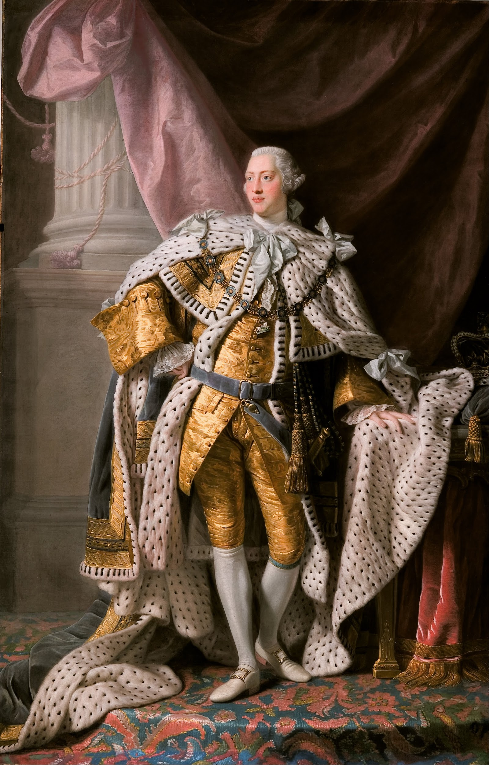
King George III takes over the Throne of Great Britain
George III inherits the throne in 1760, the middle of the Seven Years’ War, which lasted from 1756 to 1763

Slide 3
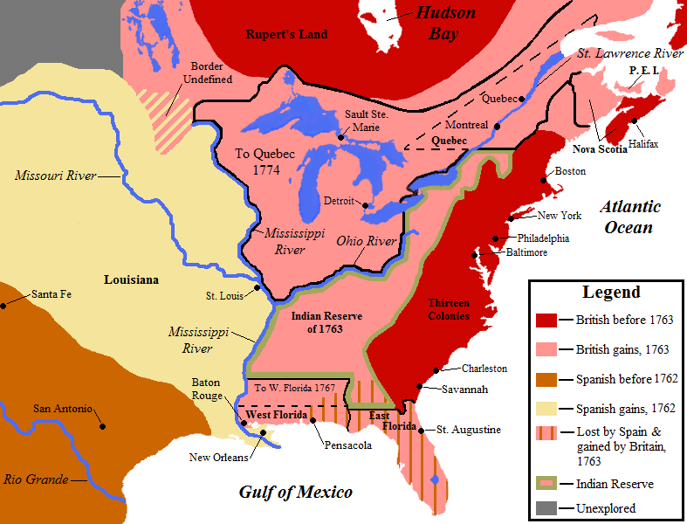
Treaty
of
Paris
1763

Slide 4



Ireland
Germany
Scotland

Slide 5
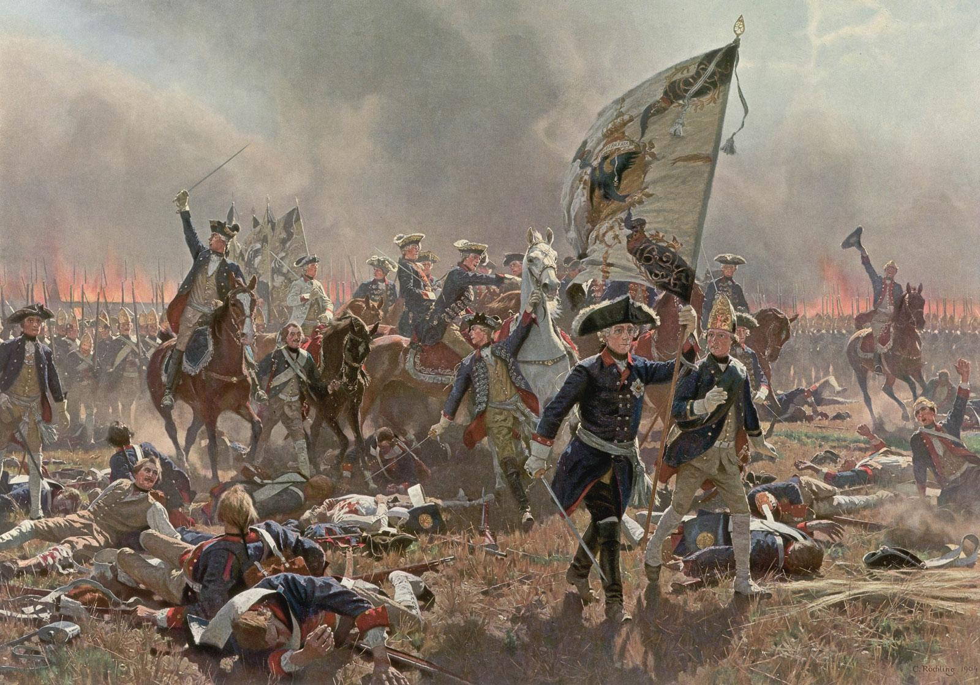
Post-War Poverty
Following the Seven Years’ War, Great Britain found themselves in massive debt
As we will see later, in order to provide revenue for the struggling nation, British Parliament eventually decides to tax the Colonies

Slide 6
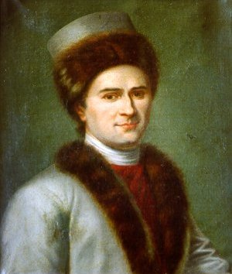
Across the Pond in France
Jean-Jacques Rousseau Published
The Social Contract
1762

Slide 7
Rousseau's Lack of Popularity
His book was not well received by everyone
Governments everywhere banned the book
His hometown of Geneva burned the book and threatened to arrest him if he ever returned.
Fellow French Enlightenment philosopher Voltaire wrote to Rousseau having received a copy of The Social Contract
“I have received your new book against the human race, and thank you for it. Never was such a cleverness used in the design of making us all stupid. One longs, in reading your book, to walk on all fours. But as I have lost that habit for more than sixty years, I feel unhappily the impossibility of resuming it.”

Slide 8

Voltaire
Voltaire’s Candide added to the index librorum prohibitorum on May 24, 1762 after being banned by Geneva
"Let us eat a Jesuit"

Slide 9
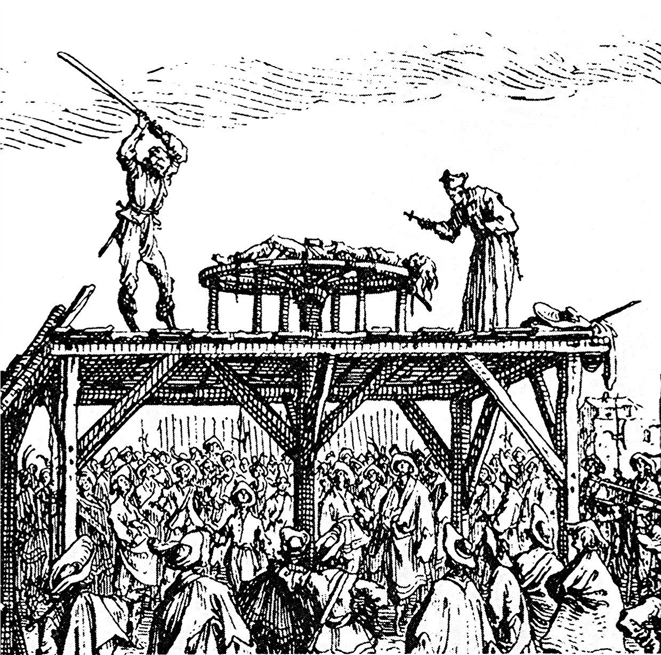
Chruch Sanction Torture Inspiring Radicalism
Inspires Voltaire and confirms his hatred of established religion
March 10, 1762 Jean Calas: Broken on the Wheel
July 1, 1766 Chevalier de La Barre: Beheaded

Slide 10
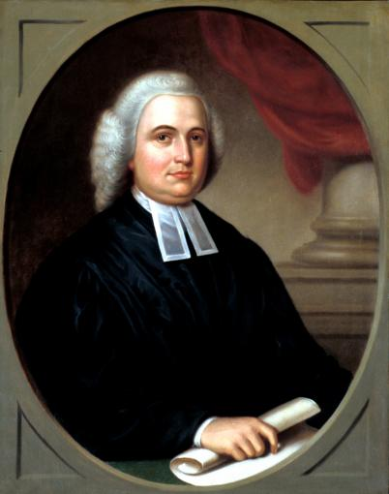
Hey Rhode Island, can I start a “Baptist” university here?
-1764
James Manning

Slide 11
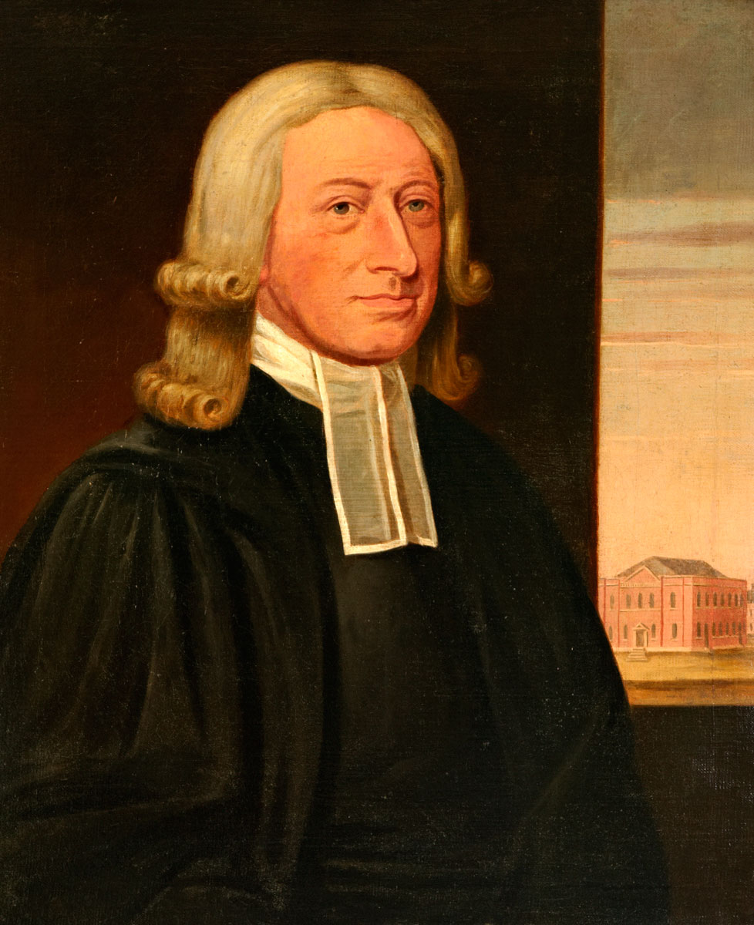
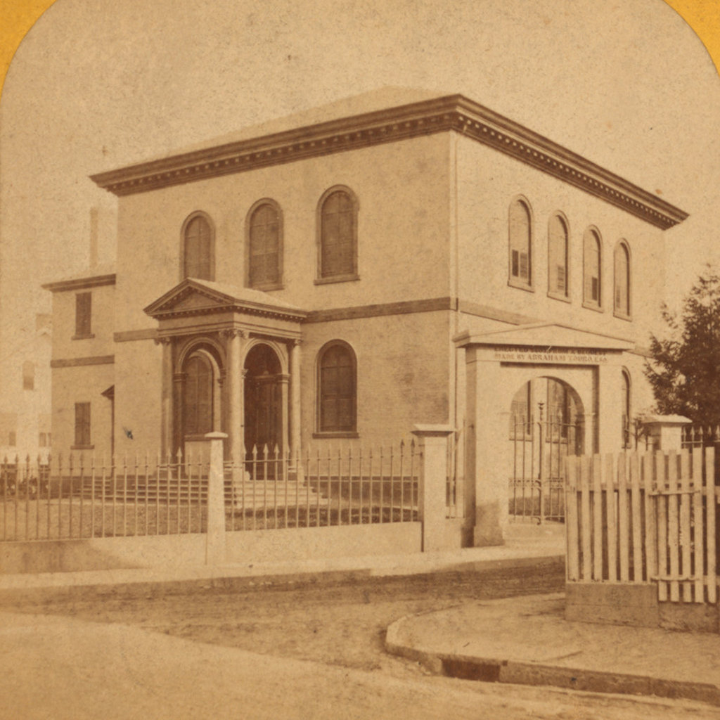
John Wesley
1769
Touro Synagogue
1763

Slide 12
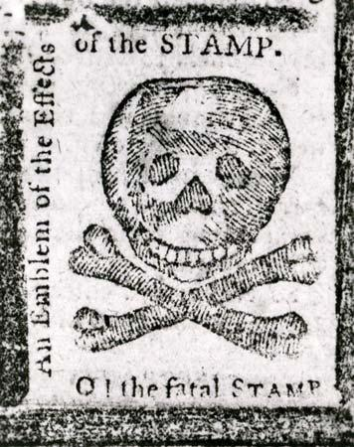
The Stamp Act of 1765
The Stamp Act was the first tax imposed on the Colonies by British Parliament
Obviously, the response in the Colonies was not a positive one. The ensuing events paved the way for the American Revolution

Slide 13
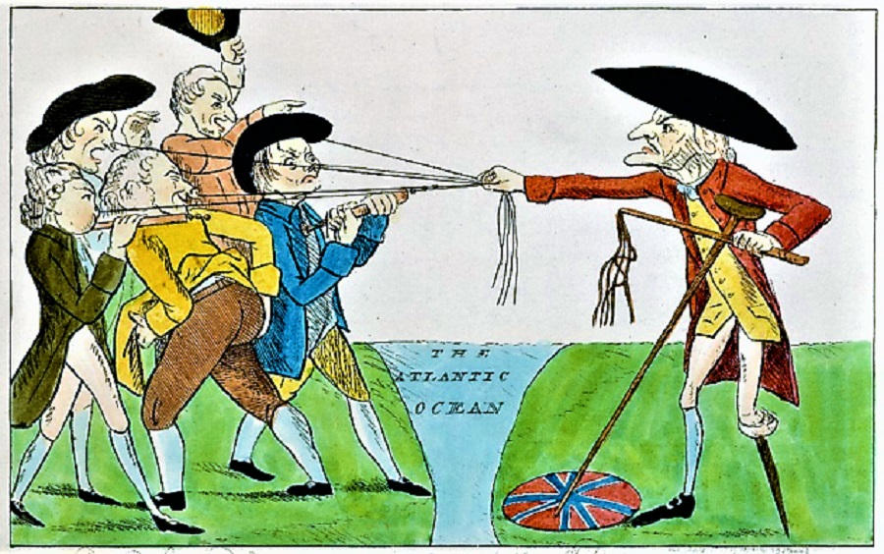
The Declaratory Act of 1766
Though the Stamp Act was repealed the following year in 1766, British Parliament accompanied the repeal with a strengthening of their power over the Colonies through the Declaratory Act

Slide 14
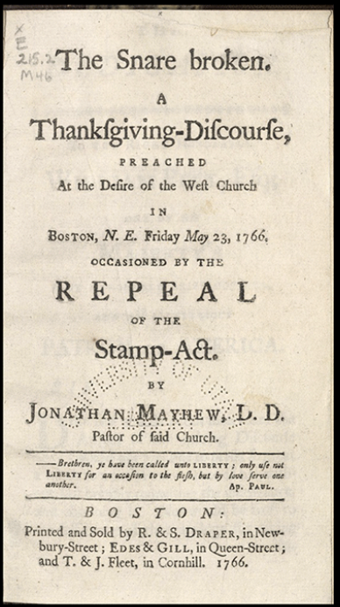
Jonathan Mayhew’s Politically Motivated Sermons
Pastors like Jonathan Mayhew preached extensively on these pre-Revolutionary principles
Their exposition of Scripture was, at times, heavily influenced by the political climate

Slide 15
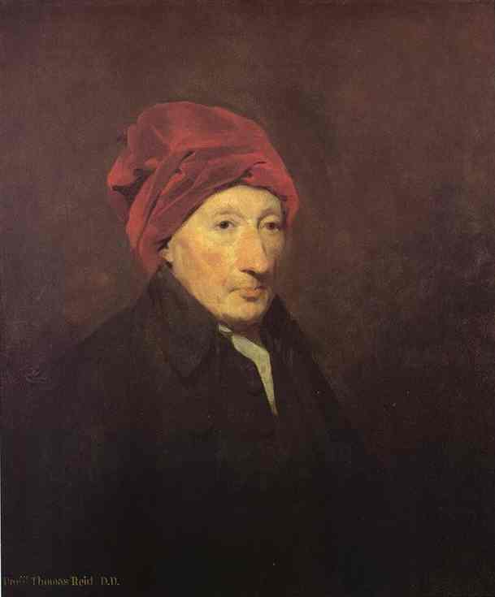
Thomas Reid founds what he names Scottish Philosophy by writing Inquiry into the Human Mind on the Principles of Common Sense in 1764

Slide 16
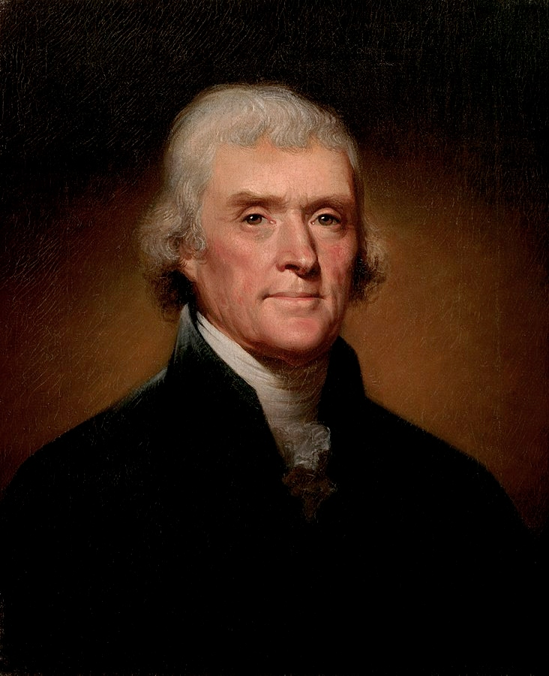
The Beginning of the American Deist Movement
Like most revolutionaries of the Modern Age, Thomas Jefferson was radicalized in College
First Exposed to Enlightenment ideas through William Small

Slide 17
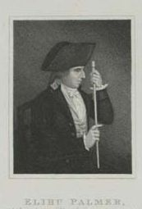
Elihu Palmer (someone you have never heard of) is born

Slide 18
Something was Rotten in the State of New England...
VS
Anglican Desire for Bishops
Congregationalists and Presbyterians

Slide 19
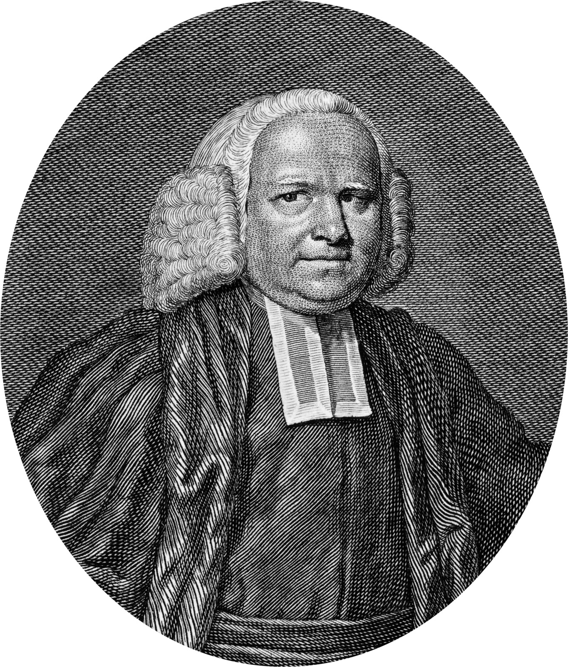
Sects- groups that stayed under the Christian umbrella but broke off into “pure” communities of ethics and doctrine based upon their interpretation of scripture
George Whitefield dies September 30th, 1770
Sandemanians
Quakers
Mennonites
United Society of Believers in Christ’s Second Appearing

